Slide 1
A Bias Aware News Recommendation System
Paper 102
ICSC 2019
Anish Patankar, Joy Bose, Harshit Khanna
Samsung R&D Bangalore, India

Slide 2
Outline
Problem Statement
Related Approaches
Components of our approach
Experimental results
Conclusion and future work

Slide 3
Problem Statement
Build a system to automatically detect and flag fake news in real time.
Focus on news articles
Enable users to access varying viewpoints on a given news topic
Many users are caught in bubbles, i.e. they only read news from sources that they agree with.

Slide 4
Current Approaches
Two main approaches
Partner with fact checking networks (Google, OpenMind plugin, BS detector)
Poll users for trust in news sources (Facebook and others)
Issue with these approaches:
Restrict user choice and is tantamount to censorship
As long as fake content (or amount of bias) is flagged, the user should be able to decide what kind of news articles they wish to read.
We present an alternative solution that seeks to give more choice to the end user to make an informed decision.

Slide 5
Our approach
Step 1: Inform the reader how much the news article is biased by calculating and displaying a bias score to benchmark the current article with others
Step 2: Offer recommendations from other news sources on the same topic as the current news article.

Slide 6
Definition of bias score
We compute a bias score to indicate the level of bias
Bias score for a sentence = (Number of biased words*)/ (Total number of words)
Based on Wikipedia NPOV bias lexicon by Recasens et. al.
Bias score for article = Σ(biased score for sentence) / (Number of sentences)

Slide 7
Pre-processing of News Articles
News article text extracted from web pages using Boilerpipe (readability tool based on "Boilerplate Detection using Shallow Text Features" by Christian Kohlschütter et al., presented at WSDM 2010)
The news article is pre-processed through sentence tokenizer and then the bias detection algorithm runs on each sentence.

Slide 8
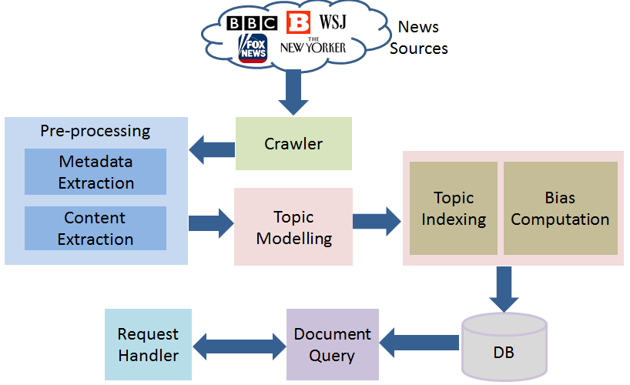
System architecture

Slide 9
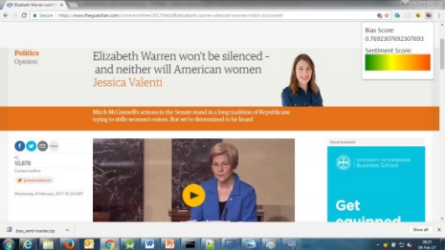
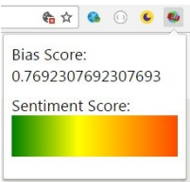
Web Browser Extension to Display Bias Score

Slide 10
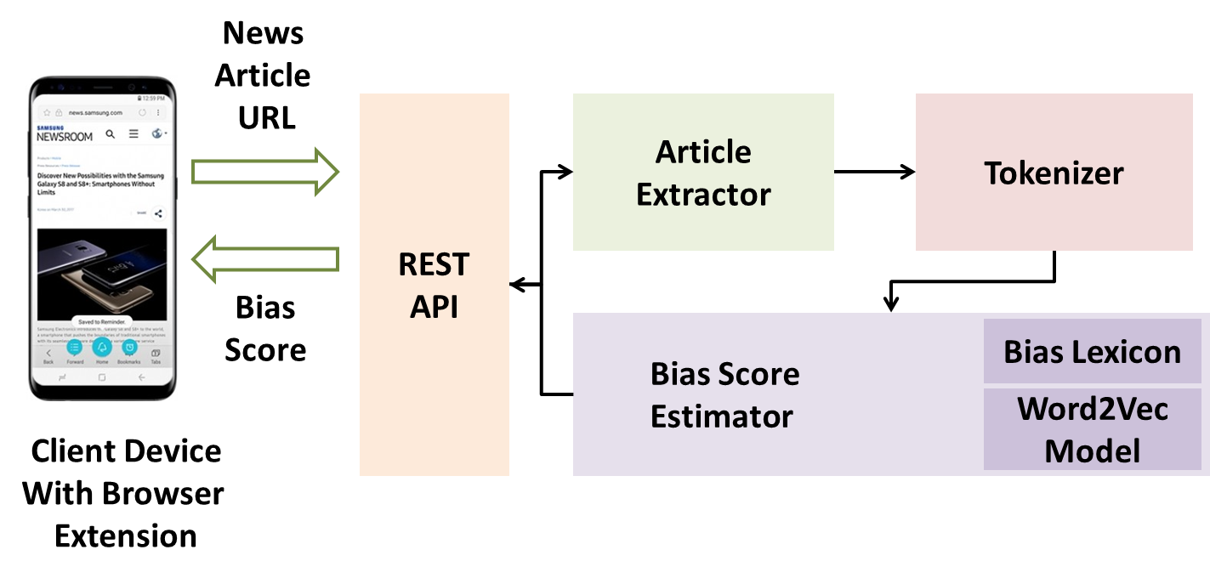
System to get bias score in real time

Slide 11
Crawler for news articles
Crawl news content from a variety of news sources.
We select media sources from the Pew Research study (mix of liberal and conservative audience)
Based on the availability of the robots.txt and sitemap files, we selected the following five media sources: New Yorker (liberal and non-mainstream), New York Times (liberal and mainstream), BBC (liberal and mainstream), Fox News (conservative and mainstream), and Breitbart (conservative and non-mainstream).
For each crawled article, we compute bias score
For indexing, we use an LDA based system (Sailesh et al, 2016) to give related news articles on same topic

Slide 12
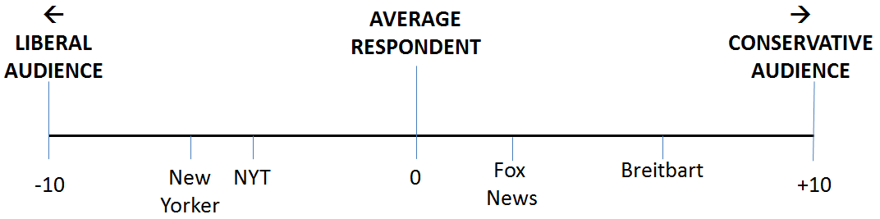
Audience of news sources (Pew Research study)

Slide 13
System Components
The components of the system to compute the bias score for news articles are as follows:
REST API: Front end to communicate with the client browser extension
Article Extractor and Tokenizer: Preprocessing steps to extract article content (done by Boilerpipe)
Bias Lexicon: Based on Wikipedia NPOV (Neutral Point of View) Lexicon, taken from Recasens et. al
Word2Vec Model: Trained on all articles from English Wikipedia
Bias Score estimator: Runs the algorithm to compute the bias score for the article.
The bias score is displayed via a web browser extension on the client device.

Slide 14
Algorithm: Bias Score for a Sentence
COMPUTE-NPOV-SCORE-SENTENCE() // Compute NPOV score for given sentence
s = sentence; // Input
biased_words = Set of biased words from the NPOV lexicon; // Input
w2v_model = Word2Vec Model trained on Wikipedia articles corpus; // Input
count = count of similar words in sentence; //Input
similarity_threshold = Threshold for similarity //Input
npov_count = NPOV score for sentence; // Output
total_words = GET-WORD_COUNT(s); //Word count in the sentence
npov_count = 0;
for i: 1 to total_words
if (word in w2v_model)
for biasword in biased_words
similarity_score = w2vmodel.similarity (word, biasword); // Word2vec similarity score if similarity_score > similarity_threshold
npov_count = npov_count + 1
break
return npov_count;

Slide 15
Algorithm: Bias Score for an Article
A = article; // Input
sentences = tokenize(A); //Split into sentences using tokenizer
bias_count = 0;
total_word_count = 0;
for s in sentences
sen_score = COMPUTE-NPOV-SCORE-SENTENCE(s);
bias_count = bias_count + sen_score;
total_word_count = word_count + word_count(s);
return bias_count / total_word_count;

Slide 16

Browser UI: Showing related news articles

Slide 17
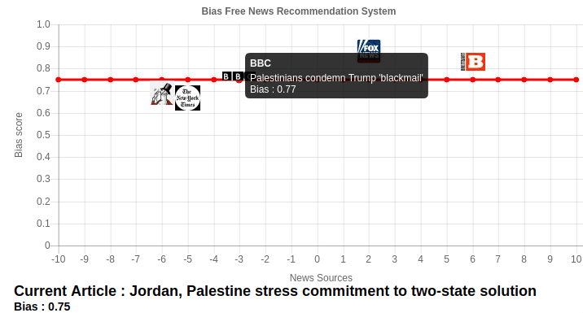
Browser Popup: showing related news articles

Slide 18
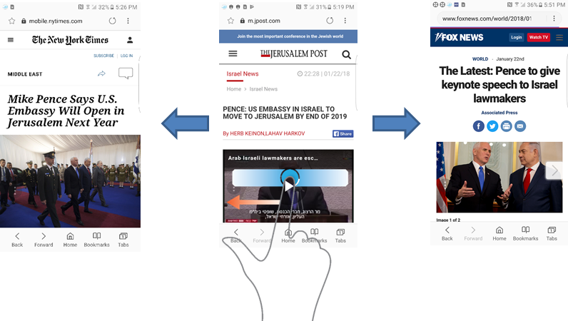
Mobile browser: related news articles

Slide 19
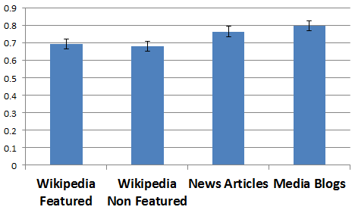
Experimental results: Mean bias scores of different types of articles

Slide 20
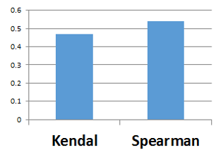
Correlation of algo and user rankings of bias
Article URL | Aggregated User Rank | Predicted Rank
wsws.org/en/articles/2018/01/06/paki-j06.html | 3 | 5
newyorker.com/news/news-desk/the-tapi-pipeline-and-paths-to-peace-in-afghanistan | 5 | 3
nytimes.com/2018/01/09/opinion/pakistan-trump-aid-engage.html?mtrref=undefined&gwh=7973905D6242465D0C400CC5DA93A330&gwt=pay&assetType=opinion | 1 | 1
bbc.com/news/world-us-canada-42574139 | 4 | 6
foxnews.com/story/2007/09/21/heritage-foundation-leveling-with-pakistan-on-afghanistan.html | 6 | 4
breitbart.com/national-security/2017/03/28/pakistan-islamabad-constructing-fence-along-afghan-border/ | 2 | 2

Slide 21
Conclusion and future work
We have described a system to recommend related URLs from the same topic from news sources with a variety of political biases.
We hope that such a system can help to enable users to be more aware of bias in news articles they are currently reading.
Our system offers a compromise between keeping user autonomy and the need to warn the users of biased or fake news.
Future work
Incorporate additional parameters such as similarity to other biased articles, context of the biased words and the number of superlative adjectives used.
Use publicly available news trust or fake news identification APIs to reward or penalize the computed bias score.
Examine the feasibility of searching relevant news articles quickly by using public search APIs.
Explore sentiment analysis along with the bias score to develop a more composite score.

Slide 22
References
Bing Liu. Sentiment analysis and subjectivity. Handbook of Natural Language Processing, Second Edition. Taylor and Francis Group. 2010.
M. Recasens, C. Danescu-Niculescu-Mizil, D. Jurafsky. Linguistic Models for Analyzing and Detecting Biased Language. ACL, 2013.
Anish Anil Patankar, Joy Bose. Bias Based Navigation for News Articles and Media. NLDB 2016, pp 465-470.
Gensim: Deep learning with word2vec. [Online]. Available: https://radimrehurek.com/gensim/models/word2vec.html
Fortuna B, Galleguillos C, Cristianini N. Detection of bias in media outlets with statistical learning methods. Text Mining. 2009.
Soo-Min Kim and Eduard Hovy. Extracting opinions, opinion holders, and topics expressed in online news media text. In Proc. Workshop on Sentiment and Subjectivity in Text. ACL, Stroudsburg, PA, USA, 2006.
Balahur A et. al. Sentiment analysis in the news. arXiv preprint arXiv:1309.6202. 2013.
Calais Guerra PH, Veloso A, Meira Jr W, Almeida V. From bias to opinion: a transfer-learning approach to real-time sentiment analysis. 17th ACM SIGKDD, 2011. ACM.
Stefano Baccianella, Andrea Esuli, and Fabrizio Sebastiani. SENTIWORDNET 3.0: An Enhanced Lexical Resource for Sentiment Analysis and Opinion Mining. LREC 2010, Malta.
C. Kohlschütter, P. Fankhauser and W. Nejdl. Boilerplate Detection using Shallow Text Features. WSDM 2010, New York, USA.
Mercury web parser. [Online]. Available: https://mercury.postlight.com/web-parser/
Bing Liu. Opinion Lexicon (or Sentiment Lexicon). [Online]. Available: https://www.cs.uic.edu/~liub/FBS/sentiment-analysis.html

